Slide 1
JOB PORTAL
MANAGEMENT SYSTEM
DARSANA R (24102817)
DIYA LAL N (24102299)
GOPIKA K (24102623)
K S MOHAMMED SHAHAL (24102259)
1

Slide 2
INTRODUCTION

Slide 3
Introduction
• Centralized web-based platform connecting job seekers and recruiters.
• Job seekers can create profiles, upload resumes, search jobs and apply online.
• Recruiters can publish vacancies, review applications and manage recruitment.
• Centralized records improve organization, accessibility and recruitment efficiency.
2

Slide 4
Aim
Primary Aim
Expected Outcome
To provide a centralized web-based job portal that simplifies job searching and streamlines recruitment activities.
Enable candidates and recruiters to interact through an organized, accessible and secure recruitment platform.
3

Slide 5
Objective
• Enable job seekers to maintain profiles and resumes and search for suitable jobs.
• Allow online job applications and application-status tracking.
• Allow recruiters to create, update and manage job vacancies and applications.
• Provide administrators with user, recruiter and platform management controls.
4

Slide 6
Scope
• Job discovery: search and filter opportunities using location, salary, experience and job type.
• Recruitment management: job posting, applicant review, shortlisting and decisions.
• Administration: user management, recruiter approval and monitoring.
• Centralized data management for profiles, jobs, applications and administrative records.
5

Slide 7
FUNCTIONAL REQUIREMENTS

Slide 8
Functional Requirements
R.1 LOGIN
R.1.1 Job Seeker Login
Description: The system shall authenticate registered job seekers using valid credentials and grant access to their dashboard.
Input: Email , Password
Output: Redirected to Job Seeker Dashboard
R.1.2 Recruiter Login
Description: The system shall authenticate registered recruiters and allow access to the recruiter dashboard after successful login.
Input: Recruiter Email/Username, Password
Output: Redirected to Recruiter Dashboard

Slide 9
Functional Requirements
R.1.3 Admin Login
Description: The system shall allow the administrator to log in securely using admin credentials to manage users, recruiters, and job postings.
Input: Admin Username, Password.
Output: Redirected to Admin Dashboard.
R.2 USER REGISTRATION
Description: The system shall allow new users (job seekers and recruiters) to create an account
in order to access the job portal services.
Input: Name, Email, Password.
Output: “Registered Successfully”.
6

Slide 10
Functional Requirements
R.3 JOB SEEKER PROFILE CREATION
Description: The system shall allow job seekers to create and update their professional profile by entering educational qualifications, skills, and uploading their resume.
Input: Qualification, Skills, Resume
Output: Profile Created Successfully
R.4 SEARCH JOBS
Description: The system shall allow job seekers to search for jobs using filters such as location,
salary range, experience level, and job type.
Input: Location, Salary, Experience, Job Type
Output: List of Available Jobs

Slide 11
Functional Requirements
R.5 VIEW JOB DETAILS
Description: The system shall allow users to view complete job information including job description, company details, required skills, salary, and application deadline.
Input: Select Job
Output: Detailed Job Information Displayed
R.6 APPLY FOR JOBS
Description: The system shall allow job seekers to apply for a selected job by submitting their resume and required details.
Input: Click Apply, Upload Resume
Output: “Application Submitted Successfully”.

Slide 12
Functional Requirements
R.7 POST JOB
Description: The system shall allow recruiters to create and publish job postings by entering job
details such as title, skills, salary, experience, and location.
Input: Job Title, Skills, Salary, Experience, Location
Output: “Job Posted Successfully”
R.7 UPDATE/DELETE JOB
Description: The system shall allow recruiters to modify or remove previously posted job listings.
Input: Select Job
Output: Job Updated or Deleted Successfully

Slide 13
Functional Requirements
R.8 VIEW APPLICATIONS
Description: The system shall allow recruiters to view the list of candidates who have applied
for a particular job posting.
Input: Click “View Applications”
Output: List of Applicants Displayed
R.9 ACCEPT/REJECT CANDIDATE
Description: The system shall allow recruiters to review applications and accept or reject
candidates. The system shall notify the candidate about the decision.
Input: Recruiter Selection (Accept/Reject)
Output: Candidate Notified

Slide 14
Functional Requirements
R.10 RECRUITER APPROVAL
Description: The system shall allow the admin to review newly registered recruiters and approve
or reject their registration before granting full access to job posting features.
Input: Recruiter Registration Request
Output: Recruiter Approved or Rejected
R.11 MANAGE USERS
Description: The system shall allow the administrator to manage registered users to maintain system security
and data integrity. The admin can monitor user activities, delete fake or inactive accounts, block
users who violate policies, and maintain the overall user database.
Input: Admin selects user account
Output: User deleted, blocked, or database updated successfully

Slide 15
NON FUNCTIONAL REQUIREMENTS

Slide 16
Non Functional Requirements
1. PERFORMANCE
The system must be fast and responsive, even when handling large user data. System should load pages quickly and support many users simultaneously
2. COMPATIBILITY
System works on:
Mobile
Tablet
Laptop
All browsers (Chrome, Edge, Firefox)

Slide 17
Non Functional Requirements
3. SECURITY
Security ensures that the data stored in the Job Portal Management System is protected from unauthorized access and misuse. The system must safeguard sensitive information such as user credentials, personal details, and job application data. Proper authentication and authorization mechanisms should be implemented to ensure that only valid users can access the system.
4.USABILITY
System should provide a simple, clear, and user-friendly interface so that both job seekers and recruiters can use the system without difficulty. The system should include clear navigation, understandable instructions, and well-organized features that allow users to quickly perform tasks such as job searching, job posting, and application submission.

Slide 18
MODULES AND WORKING

Slide 19
Modules
1.JOB SEEKER MODULE
This module provides functionalities for job seekers to create and manage profiles containing personal, educational, and professional details.
Users can search and filter job listings based on skills, location, and job title . Applications can be submitted only after uploading the resume.
The module also enables applicants to save preferred jobs for future reference, and track the status of their applications, such as applied, shortlisted, selected, or rejected.
Resume management and application history are maintained through relational tables.
7

Slide 20
Modules
2.EMPLOYER
The Employer Module is designed to help recruiters efficiently manage the recruitment process.
The Employer module enables recruiters to register organizations, post and manage job vacancies, and review applicant profiles.
New job vacancies can be posted with information such as job title, qualifications, salary, experience requirements, and job description.
Employers can shortlist candidates, update application statuses, and communicate decisions.
The module also allows recruiters to edit, update, or delete job postings whenever necessary.
Database relationships ensure consistency between job postings, employers, and applicants.
7

Slide 21
Modules
3.ADMIN
The Admin Module is responsible for controlling and managing the overall functionality of the job portal system.
This module allows administrators to securely log in and monitor the activities of both job seekers and employers
Administrators can manage user accounts, verify and approve job postings, remove fake or inappropriate job listings, and ensure that the platform operates smoothly and securely.
7

Slide 22
System Design –
Use Case Diagram

Slide 23
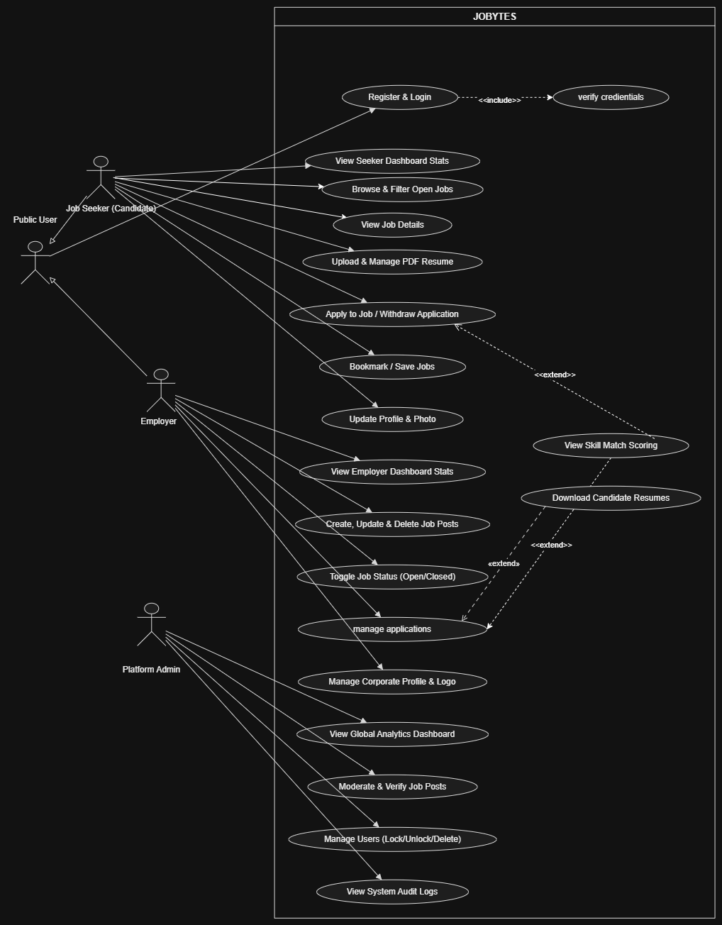
System Design – Use Case Diagram
8

Slide 24
Use Case Specification

Slide 25
8. Use Case Specification
UC-01: Register & Login
UC-02: Verify Credentials
ID | UC-01
Brief Description | The job seekers and employers can register and login to their profiles.
Primary Actor | Public User
Secondary Actor | None
Preconditions | 1. The user is not already registered with the provided email address (for registration). 2. The user has a valid email address and internet connection. 3. The user has already registered an account (for login). 4. The user's account is active (for login).
Main Flow | REGISTER: 1. The user opens the job portal and clicks the Register button. 2. The system displays the registration form. 3. The user enters the required details (name, email, password, role) and clicks the Sign Up / Register button. 4. The system validates the entered information via Verify Credentials (<<include>>). 5. The system creates a new user account. 6. The user is redirected to the login page (or logged in automatically). LOGIN: 1. The user opens the job portal and clicks the Login button. 2. The system displays the login form. 3. The user enters the registered email and password and clicks the Login button. 4. The system validates the credentials via Verify Credentials (<<include>>). 5. The system authenticates the user. 6. The system redirects the user to the dashboard / home page based on their role.
Post Conditions | REGISTER: A new user account is successfully created in the system. LOGIN: The user is successfully authenticated and redirected to their respective dashboard.
Alternative Flows | 1. If the email is already registered, the system displays an error message. 2. If credentials are invalid, the system displays an authentication failure message. 3. If the account is locked or inactive, the system denies access and notifies the user.
ID | UC-02
Brief Description | Validates user credentials during registration and login processes.
Primary Actor | System
Secondary Actor | None
Preconditions | 1. The user has submitted credentials for registration or login.
Main Flow | 1. The system receives the entered email and password. 2. The system validates the email format and password strength (for registration). 3. The system checks if the email already exists (for registration) or matches existing records (for login). 4. The system verifies the password hash against the stored value (for login). 5. The system returns a verification status to the calling use case.
Post Conditions | 1. Credentials are validated successfully, or an appropriate error is returned.
Alternative Flows | 1. Invalid email format → prompt user to re-enter. 2. Weak password → prompt for stronger password. 3. Incorrect credentials → deny access.
.
25

Slide 26
Use Case: View Seeker Dashboard Status
Use Case: Browse & Filter Open Jobs
ID | UC-03
Brief Description | Allows a job seeker to access and view their personalized dashboard after logging into the system. The dashboard displays profile information, job recommendations, applied jobs, saved jobs, and notifications.
Primary Actor | Job Seeker
Secondary Actor | None
Preconditions | 1. The job seeker is registered. 2. The job seeker is logged in successfully. 3. The system is operational and connected to the database.
Main Flow | 1. The job seeker logs into the system. 2. The system retrieves the job seeker's profile and dashboard data from the database. 3. The system displays the dashboard with profile details, recommended jobs, applied jobs, saved jobs, and notifications. 4. The job seeker views the dashboard and selects the desired option for further actions.
Post Conditions | 1. The job seeker's dashboard is successfully displayed. 2. The latest profile information, job recommendations, applied jobs, saved jobs, and notifications are retrieved and shown. 3. The job seeker can access and navigate to other dashboard features.
Alternative Flows | 1. If the database connection fails, the system displays an error message. 2. If the profile is incomplete, the system prompts the user to complete it.
ID | UC-04
Brief Description | Allows a job seeker to browse available job postings and filter them based on criteria such as job title, location, company, or experience level.
Primary Actor | Job Seeker
Secondary Actor | None
Preconditions | 1. The job seeker is logged into the system. 2. The system is operational and connected to the database. 3. Job postings are available in the system.
Main Flow | 1. The job seeker opens the Browse Jobs page. 2. The system displays all available job listings. 3. The job seeker enters search keywords or selects filter criteria (location, job type, salary, experience level, etc.). 4. The system processes the selected filters. 5. The system retrieves matching job listings from the database. 6. The system displays the filtered job results. 7. The job seeker browses the results and selects a job to view its details.
Post Conditions | 1. The filtered list of jobs is displayed to the job seeker. 2. The selected search and filter criteria are applied successfully. 3. The job seeker can view job details or proceed to apply for a job.
Alternative Flows | 1. If no jobs match the filters, the system displays a 'No results found' message. 2. If the database is unreachable, the system shows an error notification.
26

Slide 27
Use Case: Upload & Manage PDF Resume
Use Case: View Job Details
.
ID | UC-05
Brief Description | Allows a job seeker to view the full details of a specific job posting including description, requirements, salary, company info, and application instructions.
Primary Actor | Job Seeker
Secondary Actor | None
Preconditions | 1. The job seeker is logged into the system. 2. The job seeker is on the browse jobs or dashboard page. 3. Job postings are available in the system.
Main Flow
Post Conditions
Alternative Flows | 1. The job seeker clicks on a job listing from the browse results or recommendations. 2. The system retrieves the detailed job information from the database. 3. The system displays the job details page (title, description, requirements, salary range, location, company, posted date, deadline). 4. The job seeker reviews the details. 5. The system optionally displays View Skill Match Scoring (<<extend>>) if the seeker has uploaded a resume.
 | 1. The job details are successfully displayed. 2. The job seeker can proceed to apply, save, or return to browsing.
ID | UC-06
Brief Description | Allows a job seeker to upload a new PDF resume, replace an existing one, or delete their resume from the system.
Primary Actor | Job Seeker
Secondary Actor | None
Preconditions | 1. The job seeker is logged into the system. 2. The job seeker has a valid PDF file (for upload).
Main Flow | UPLOAD: 1. The job seeker navigates to the Profile / Resume section. 2. The system displays the current resume status (uploaded / not uploaded). 3. The job seeker clicks Upload / Replace Resume and selects a PDF file. 4. The system validates the file type (PDF) and size. 5. The system stores the resume file and updates the profile record. 6. The system displays a success confirmation. DELETE: 1. The job seeker clicks Delete Resume. 2. The system prompts for confirmation. 3. Upon confirmation, the system removes the resume file and updates the profile.
Post Conditions | 1. The resume is successfully uploaded, replaced, or deleted. 2. The profile is updated with the latest resume reference.
Alternative Flows | 1. Invalid file type → system rejects and prompts for PDF. 2. File size exceeds limit → system requests a smaller file. 3. Upload fails → system shows an error and allows retry.
27

Slide 28
Use Case: View Skill Match Scoring (<<extend>>)
Use Case: Apply to Job / Withdraw Application
ID | UC-08
Brief Description | Analyzes the job seeker's resume skills against a job's requirements and displays a match percentage with a skill breakdown.
Primary Actor | System
Secondary Actor | None
Main Flow | 1. The job seeker has uploaded a PDF resume. 2. The job posting has defined skill requirements. 3. The user is viewing job details (seeker) or an application (employer).
 | 1. The system extracts skills from the seeker's resume. 2. The system compares extracted skills with the job's required skills. 3. The system calculates a match percentage score. 4. The system generates a visual breakdown (matched skills, missing skills, additional skills). 5. The system displays the score and breakdown to the user.
Post Conditions | 1. The skill match score is calculated and displayed. 2. The user can make an informed decision based on the score.
Alternative Flows | 1. No resume uploaded → system prompts to upload a resume. 2. No skills detected in resume → system shows a low score with a note. 3. Job has no skill requirements → match score is not applicable.
ID | UC-07
Brief Description | Allows a job seeker to submit an application for an open job or withdraw a previously submitted application.
Primary Actor | Job Seeker
Secondary Actor | None
Preconditions | 1. The job seeker is logged into the system. 2. The job seeker has viewed the job details. 3. A resume is uploaded (for apply). 4. The job post status is Open. 5. The job seeker has already applied (for withdraw).
Main Flow | APPLY: 1. The job seeker clicks the Apply button on the job details page. 2. The system verifies the job is open and the user has a resume. 3. The system records the application with timestamp and resume reference. 4. The system updates the job seeker's applied jobs list. 5. The system notifies the employer. 6. The system displays a confirmation to the job seeker. WITHDRAW: 1. The job seeker navigates to Applied Jobs and selects an application. 2. The job seeker clicks Withdraw Application. 3. The system prompts for confirmation. 4. Upon confirmation, the system removes / marks the application as withdrawn. 5. The system notifies the employer of the withdrawal. 6. The system updates the seeker's dashboard.
Post Conditions | 1. The application is successfully submitted or withdrawn. 2. All relevant parties are notified. 3. Dashboard and statistics are updated.
Alternative Flows | 1. Job is closed → system prevents application. 2. Already applied → system prevents duplicate application. 3. Withdrawal deadline passed → system denies withdrawal.
27

Slide 29
Use Case: Bookmark / Save Jobs
Use Case: Update Profile & Photo
ID | UC-09
Brief Description | Allows a job seeker to save or bookmark job postings for quick access later from their dashboard.
Primary Actor | Job Seeker
Secondary Actor | None
Preconditions | 1. The job seeker is logged into the system. 2. The job seeker is viewing a job listing or job details page.
Main Flow | SAVE: 1. The job seeker clicks the Save / Bookmark icon on a job listing. 2. The system adds the job to the seeker's saved jobs list. 3. The system updates the bookmark icon state to 'saved'. 4. The system displays a confirmation message. UNSAVE: 1. The job seeker clicks the saved bookmark icon again. 2. The system removes the job from the saved list. 3. The system updates the icon and confirms removal.
Post Conditions | 1. The job is successfully added to or removed from the saved jobs list. 2. The saved jobs list on the dashboard is updated.
Alternative Flows | 1. Job already saved → system removes the bookmark (toggle behavior). 2. Job is closed or deleted → system removes it from saved list and notifies the user.
ID | UC-10
Brief Description | Allows a job seeker to update their personal profile information and upload or change their profile photo.
Primary Actor | Job Seeker
Secondary Actor | None
Preconditions | 1. The job seeker is logged into the system. 2. The job seeker has navigated to the profile settings page.
Main Flow | 1. The job seeker clicks Edit Profile. 2. The system displays the current profile information in an editable form. 3. The job seeker updates fields (name, contact, skills, experience, education, etc.). 4. The job seeker optionally uploads a new profile photo. 5. The job seeker clicks Save Changes. 6. The system validates the updated information. 7. The system saves the changes to the database and updates the photo file. 8. The system displays a success confirmation.
Post Conditions | 1. The profile information and/or photo are successfully updated. 2. The updated profile is reflected across the system (dashboard, applications).
Alternative Flows | 1. Invalid input format → system highlights errors and requests correction. 2. Photo file too large or wrong format → system rejects and specifies requirements. 3. Database update fails → system shows error and allows retry.
28

Slide 30
Use Case: Create, Update & Delete Job Posts
Use Case: Update Profile & Photo
ID | UC-12
Brief Description | Allows an employer to create new job postings, edit existing ones, or remove them from the platform.
Primary Actor | Employer
Secondary Actor | None
Preconditions | 1. The employer is logged into the system. 2. The employer has completed their corporate profile (for create). 3. The job post exists (for update / delete).
Main Flow | CREATE: 1. The employer clicks Post a New Job. 2. The system displays the job creation form. 3. The employer enters job details (title, description, requirements, salary, location, type, skills, deadline). 4. The employer clicks Publish. 5. The system validates the information. 6. The system saves the job post and sets status to Pending Moderation (or Open if auto-approved). 7. The system displays a confirmation. UPDATE: 1. The employer selects an existing job post and clicks Edit. 2. The system displays the pre-filled form. 3. The employer modifies fields and clicks Save Changes. 4. The system validates and updates the job post. DELETE: 1. The employer selects a job post and clicks Delete. 2. The system prompts for confirmation. 3. Upon confirmation, the system removes the job post and related applications.
Post Conditions | 1. The job post is successfully created, updated, or deleted. 2. The employer's job list and dashboard are updated. 3. Applicants are notified if a job is deleted.
Alternative Flows | 1. Missing required fields → system highlights errors. 2. Job has active applications → system warns before deletion. 3. Employer exceeds posting limit → system shows upgrade prompt.
ID | UC-10
Brief Description | Allows a job seeker to update their personal profile information and upload or change their profile photo.
Primary Actor | Job Seeker
Secondary Actor | None
Preconditions | 1. The job seeker is logged into the system. 2. The job seeker has navigated to the profile settings page.
Main Flow | 1. The job seeker clicks Edit Profile. 2. The system displays the current profile information in an editable form. 3. The job seeker updates fields (name, contact, skills, experience, education, etc.). 4. The job seeker optionally uploads a new profile photo. 5. The job seeker clicks Save Changes. 6. The system validates the updated information. 7. The system saves the changes to the database and updates the photo file. 8. The system displays a success confirmation.
Post Conditions | 1. The profile information and/or photo are successfully updated. 2. The updated profile is reflected across the system (dashboard, applications).
Alternative Flows | 1. Invalid input format → system highlights errors and requests correction. 2. Photo file too large or wrong format → system rejects and specifies requirements. 3. Database update fails → system shows error and allows retry.
29

Slide 31
Use Case: Manage Applications
Use Case: Toggle Job Status (Open / Closed)
ID | UC-14
Brief Description | Allows an employer to view, review, and update the status of applications received for their job postings.
Primary Actor | Employer
Secondary Actor | None
Preconditions | 1. The employer is logged in. 2. The employer has active job posts. 3. Applications have been received for at least one job post.
Main Flow | 1. The employer navigates to the Applications section. 2. The system retrieves and displays a list of applications grouped by job post. 3. The employer selects an application to view details. 4. The system displays applicant info, resume summary, and applied date. 5. The employer optionally views View Skill Match Scoring (<<extend>>). 6. The employer optionally uses Download Candidate Resumes (<<extend>>). 7. The employer updates the application status (New → Shortlisted / Rejected / Interview Scheduled / Hired). 8. The system saves the status update and notifies the job seeker.
Post Conditions | 1. The application status is successfully updated. 2. The job seeker receives a notification of the status change. 3. The employer's application statistics are updated.
Alternative Flows | 1. No applications received → system shows an empty state. 2. Job seeker withdraws application → application is marked as withdrawn. 3. Resume file missing → download option is disabled.
ID | UC-13
Brief Description | Allows an employer to quickly change the status of a job post between Open (accepting applications) and Closed (no longer accepting applications).
Primary Actor | Employer
Secondary Actor | None
Preconditions | 1. The employer is logged in. 2. The job post exists in the system. 3. The job post is not deleted or pending moderation.
Main Flow | 1. The employer navigates to My Job Posts. 2. The system displays the list of job posts with their current status. 3. The employer clicks the Toggle Status switch next to a job post. 4. The system updates the job status (Open → Closed or Closed → Open). 5. The system logs the status change. 6. The system displays a confirmation and updates the job listing visibility.
Post Conditions | 1. The job post status is successfully updated. 2. The job is visible/invisible to job seekers based on the new status. 3. The employer dashboard reflects the updated count of active jobs.
Alternative Flows | 1. Job is pending moderation → toggle is disabled. 2. Job has a scheduled deadline → system warns that toggling overrides the schedule.

Slide 32
Use Case: Download Candidate Resumes (<<extend>>)
Use Case: Manage Corporate Profile & Logo
ID | UC-16
Brief Description | Allows an employer to create and update their company profile information and upload a corporate logo.
Primary Actor | Employer
Secondary Actor | None
Preconditions | 1. The employer is logged into the system. 2. The employer has navigated to the company profile settings.
Main Flow | 1. The employer clicks Edit Company Profile. 2. The system displays the current corporate profile form (company name, description, industry, size, website, location, contact info). 3. The employer updates the fields as needed. 4. The employer uploads or replaces the company logo. 5. The employer clicks Save Changes. 6. The system validates the inputs and file. 7. The system updates the corporate profile and logo in the database and file storage. 8. The system displays a success confirmation.
Post Conditions | 1. The corporate profile and logo are successfully updated. 2. The updated profile and logo are visible on all the employer's job postings.
Alternative Flows | 1. Invalid logo format/size → system rejects and specifies requirements. 2. Duplicate company name detected → system warns the user. 3. Mandatory fields left empty → system highlights errors.
ID | UC-15
Brief Description | Allows an employer to download the PDF resume attached to a candidate's job application.
Primary Actor | Employer
Secondary Actor | None
Preconditions | 1. The employer is logged in. 2. The employer is viewing an application with an uploaded resume.
Main Flow | 1. The employer clicks the Download Resume button on the application details page. 2. The system retrieves the resume file from storage. 3. The system initiates the file download to the employer's device. 4. The system logs the download action for audit purposes.
Post Conditions | 1. The resume PDF is successfully downloaded. 2. The download is recorded in the system audit log.
Alternative Flows | 1. Resume file is missing or corrupted → system shows an error. 2. Storage service is unavailable → system shows a retry option.

Slide 33
Use Case: Moderate & Verify Job Posts
Use Case: View Global Analytics Dashboard
ID | UC-17
Brief Description | Allows the platform administrator to view system-wide analytics including user growth, job postings, application trends, and platform health metrics.
Primary Actor | Platform Admin
Secondary Actor | None
Preconditions | 1. The admin is logged in with administrative privileges. 2. The system analytics module is operational.
Main Flow | 1. The admin navigates to Global Analytics Dashboard. 2. The system aggregates data from all modules (users, jobs, applications, logs). 3. The system displays visual analytics (charts, graphs, KPIs): total users, active jobs, applications this month, top industries, platform uptime, etc. 4. The admin selects date ranges or filters to drill down into specific metrics. 5. The system updates the displayed analytics dynamically.
Post Conditions | 1. The global analytics dashboard is successfully displayed. 2. The admin can export reports or navigate to specific management sections.
Alternative Flows | 1. Analytics data is stale → system shows last updated timestamp. 2. Aggregation service is down → system shows cached data with a warning.
ID | UC-18
Brief Description | Allows the platform administrator to review, approve, reject, or request changes for job postings submitted by employers to ensure quality and compliance.
Primary Actor | Platform Admin
Secondary Actor | None
Preconditions | 1. The admin is logged in with administrative privileges. 2. There are job posts pending moderation.
Main Flow | 1. The admin navigates to the Moderation Queue. 2. The system displays a list of pending job posts. 3. The admin selects a job post to review. 4. The system displays the full job post details. 5. The admin reviews the content for compliance with platform policies. 6. The admin selects an action: Approve, Reject, or Request Changes. 7. The system updates the job post status accordingly. 8. The system notifies the employer of the moderation outcome. 9. If approved, the job becomes visible to job seekers.
Post Conditions | 1. The job post status is updated (Approved / Rejected / Changes Requested). 2. The employer is notified. 3. The moderation action is logged in the audit trail.
Alternative Flows | 1. Job post is flagged as suspicious → admin can escalate or ban the employer. 2. Employer is repeat offender → admin can restrict posting privileges.

Slide 34
Use Case: Manage Users (Lock / Unlock / Delete)
Use Case: View System Audit Logs
ID | UC-19
Brief Description | Allows the platform administrator to manage user accounts by locking, unlocking, or permanently deleting them.
Primary Actor | Platform Admin
Secondary Actor | None
Preconditions | 1. The admin is logged in with administrative privileges. 2. The target user account exists in the system.
Main Flow | 1. The admin navigates to User Management. 2. The system displays a searchable list of all user accounts. 3. The admin searches for and selects a specific user. 4. The system displays the user's account details and current status. 5. The admin selects an action: Lock Account, Unlock Account, or Delete Account. 6. The system prompts the admin for confirmation. 7. Upon confirmation, the system executes the action. 8. The system logs the action in the audit trail. 9. If locked/deleted, the system notifies the user via email.
Post Conditions | 1. The user account status is updated or the account is removed. 2. The action is recorded in the system audit logs. 3. The affected user is notified (if applicable).
Alternative Flows | 1. Admin attempts to delete own account → system prevents it. 2. User has active applications/jobs → system warns before deletion. 3. User is already in the requested state → system shows a message.
ID | UC-20
Brief Description | Allows the platform administrator to view a comprehensive log of all significant system actions performed by users and admins for security and compliance.
Primary Actor | Platform Admin
Secondary Actor | None
Preconditions | 1. The admin is logged in with administrative privileges. 2. The audit logging service is operational.
Main Flow | 1. The admin navigates to System Audit Logs. 2. The system retrieves log entries from the audit database. 3. The system displays the logs in a table (timestamp, actor, action type, target entity, IP address, result). 4. The admin applies filters (date range, user, action type). 5. The system updates the displayed logs based on filters. 6. The admin can export the filtered logs to a file.
Post Conditions | 1. The audit logs are successfully displayed. 2. The admin can review, filter, or export the logs for compliance review.
Alternative Flows | 1. No logs match the filter → system shows 'No results found'. 2. Log database is large → system paginates results. 3. Export fails → system shows error and retry option.

Slide 35
Class Diagram

Slide 36
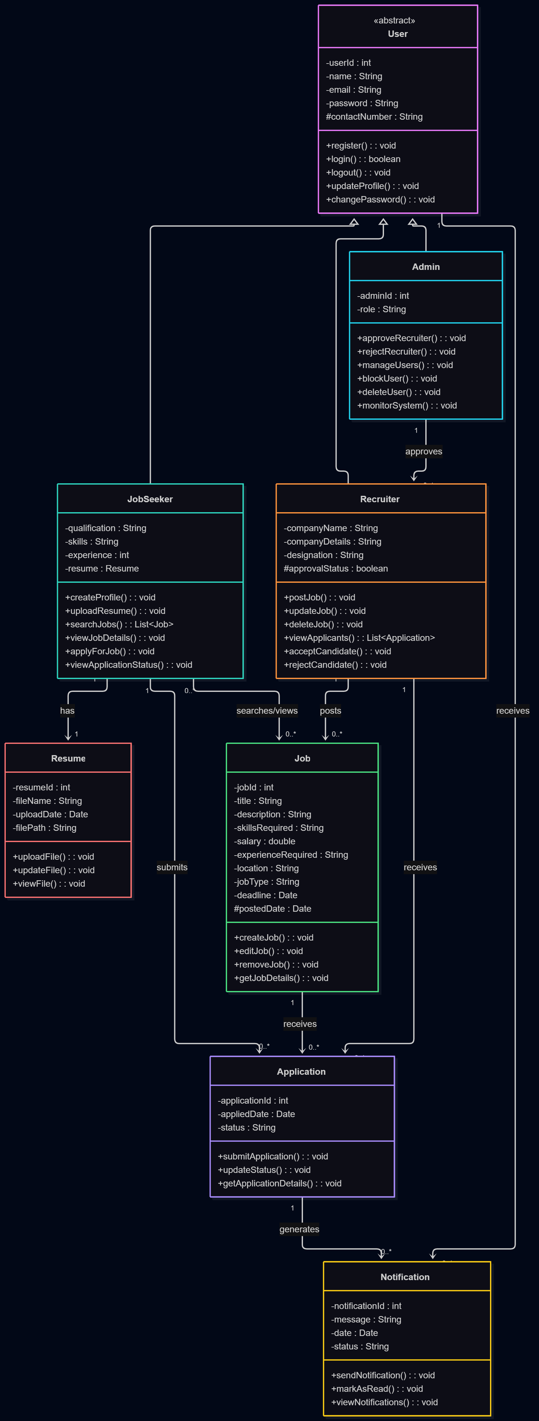
9. Class Diagram
10

Slide 37
Sequence Diagram – Apply for Job

Slide 38
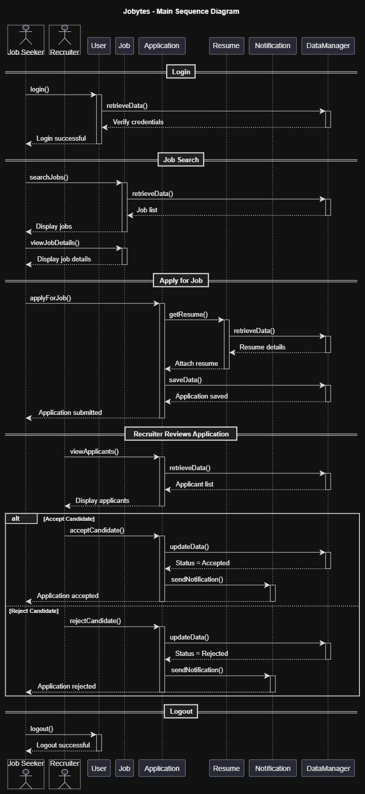
10. Sequence Diagram
11

Slide 39
Activity Diagram – Job Application

Slide 40
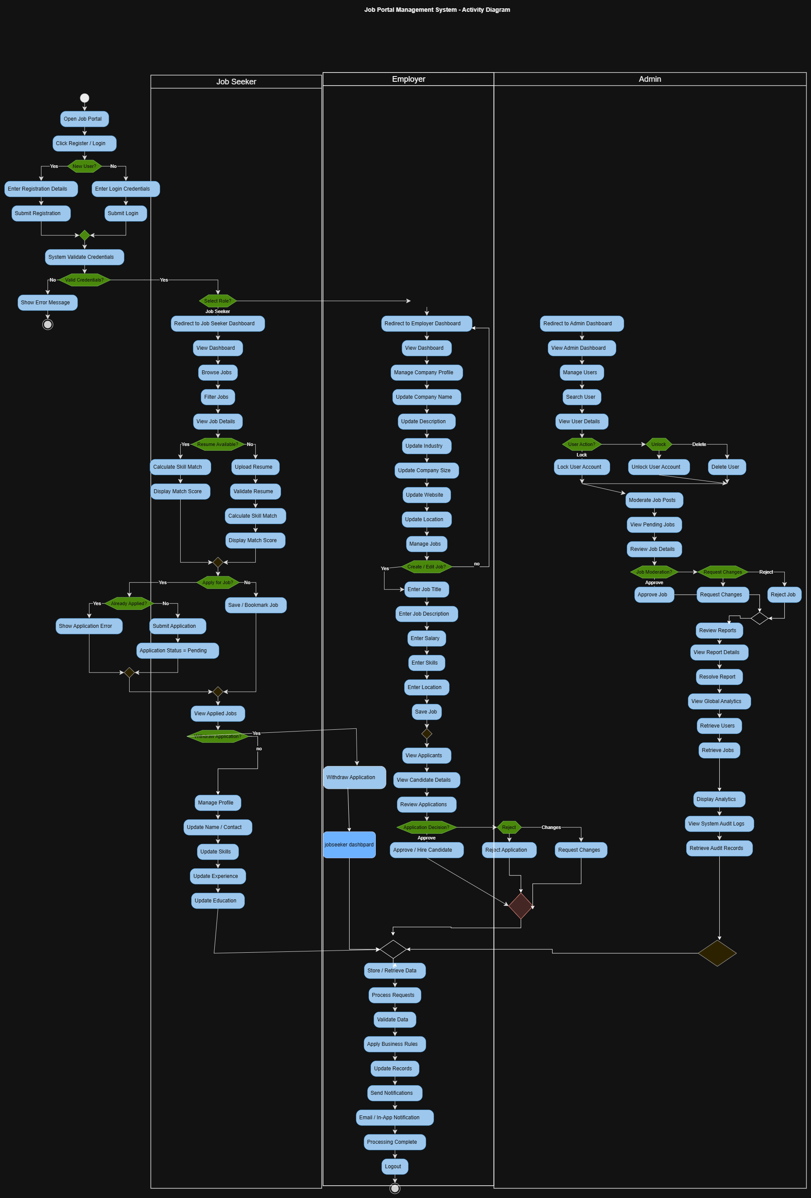
11. Activity Diagram
12

Slide 41
System Architecture & Tools

Slide 42
12. System Architecture & Tools
Frontend
Backend
Database
React
HTML
CSS
Tailwind CSS
Axios
Responsive interface for users and recruiters.
Node.js
Express.js
JWT
Handles APIs, routing, authentication, authorization and server-side logic.
MariaDB
Stores users, job seekers, employers, jobs, skills, applications, saved jobs and admin logs.
13

Slide 43
Future Scope

Slide 44
13. Future Scope
• AI-based job recommendations and automated resume parsing.
• Advanced search filters, analytics dashboards and online skill assessments.
• Android and iOS mobile applications.
• Real-time chat, email/push notifications and multilingual support.
• Freelance/remote opportunities and online video interview systems.
14

Slide 45
Conclusion

Slide 46
14. Conclusion
• The Job Portal Management System provides a centralized platform for job seekers and recruiters.
• It supports job search, applications, job posting and recruitment management.
• Centralized storage improves organization, accessibility and security of recruitment data.
• The web-based system reduces manual work and helps make recruitment more structured and efficient.
15

Slide 47
References

Slide 48
15. References
• W3Schools – HTML reference: https://www.w3schools.com/html/
• MDN Web Docs – HTML: https://developer.mozilla.org/en-US/docs/Web/HTML
• MDN Web Docs – CSS: https://developer.mozilla.org/en-US/docs/Web/CSS
• MDN Web Docs – JavaScript: https://developer.mozilla.org/en-US/docs/Web/JavaScript
• MariaDB Server Documentation: https://mariadb.com/kb/en/documentation/
16

